Slide 1

Nur
Hasan
Daniel
Shoriful
Thinance

Slide 2
Overview
1.Biography
2.Projects
3.Awards
4.Ongoing

Slide 3

Graphic Designer, StoryTeller, Producer
August 6, 1962, Austria
University of Applied Arts,Vienna
Pratt Institute, New York
Sagmeister&Walsh
Sagmeister Inc.

Slide 4

Graphic Designer, Art Director, Illustrator ,Lecturer
30, October 1986
Rhode Island School Of Design
&Walsh
Sagmeister&Walsh

Slide 5
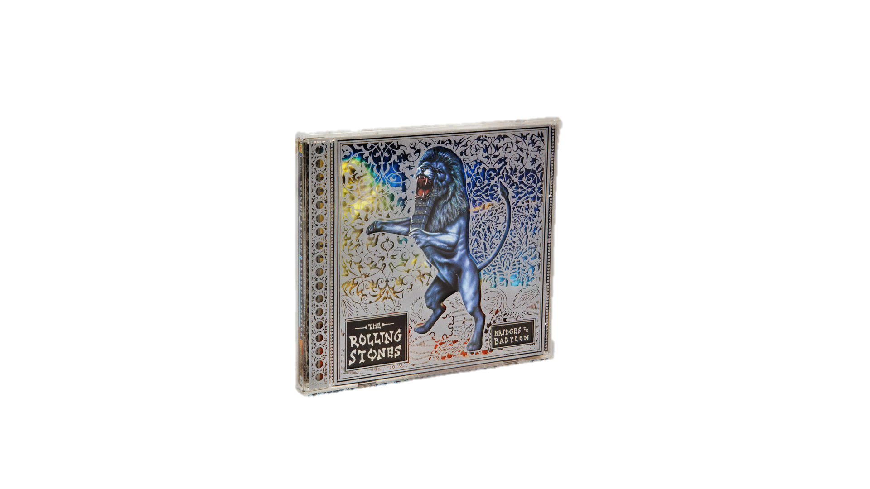



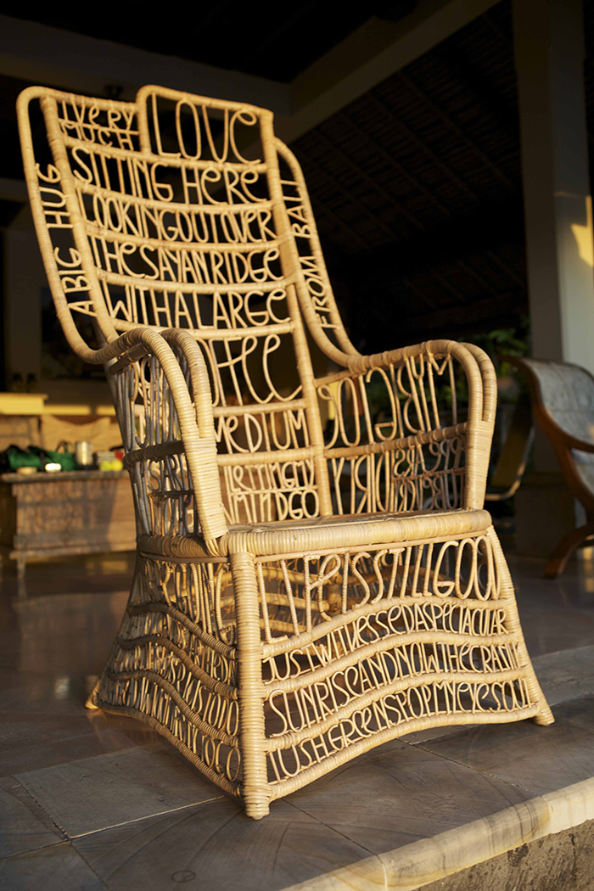

Rolling Stones
Things I´ve learn so far in my life
Lou Reed Poster
Work
Typographic Chair
Darwin Chair

Slide 6
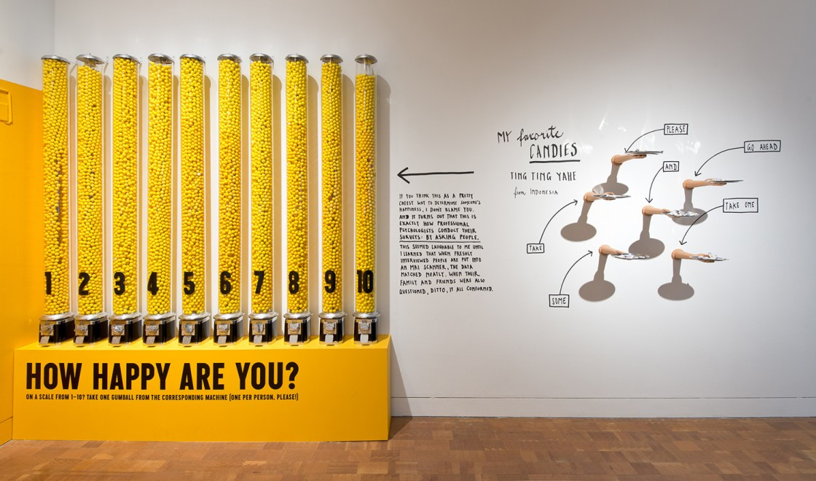
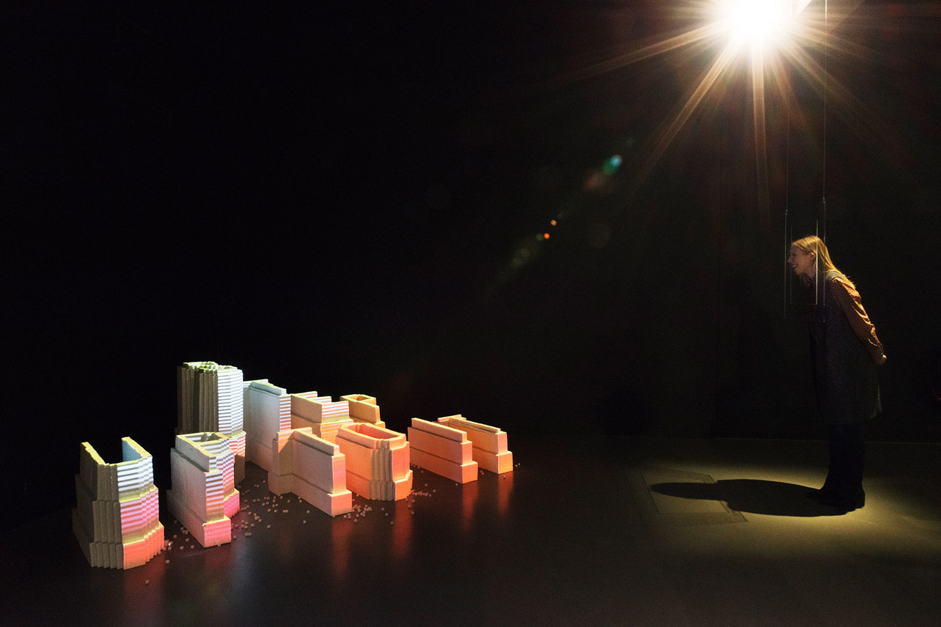
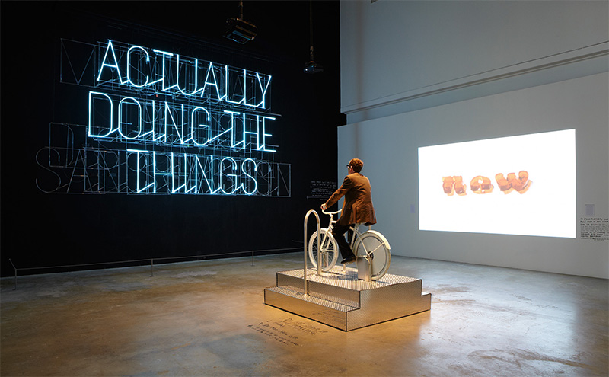
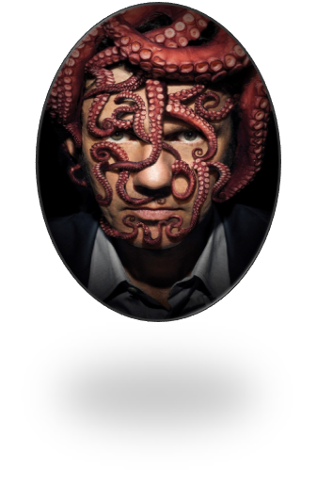
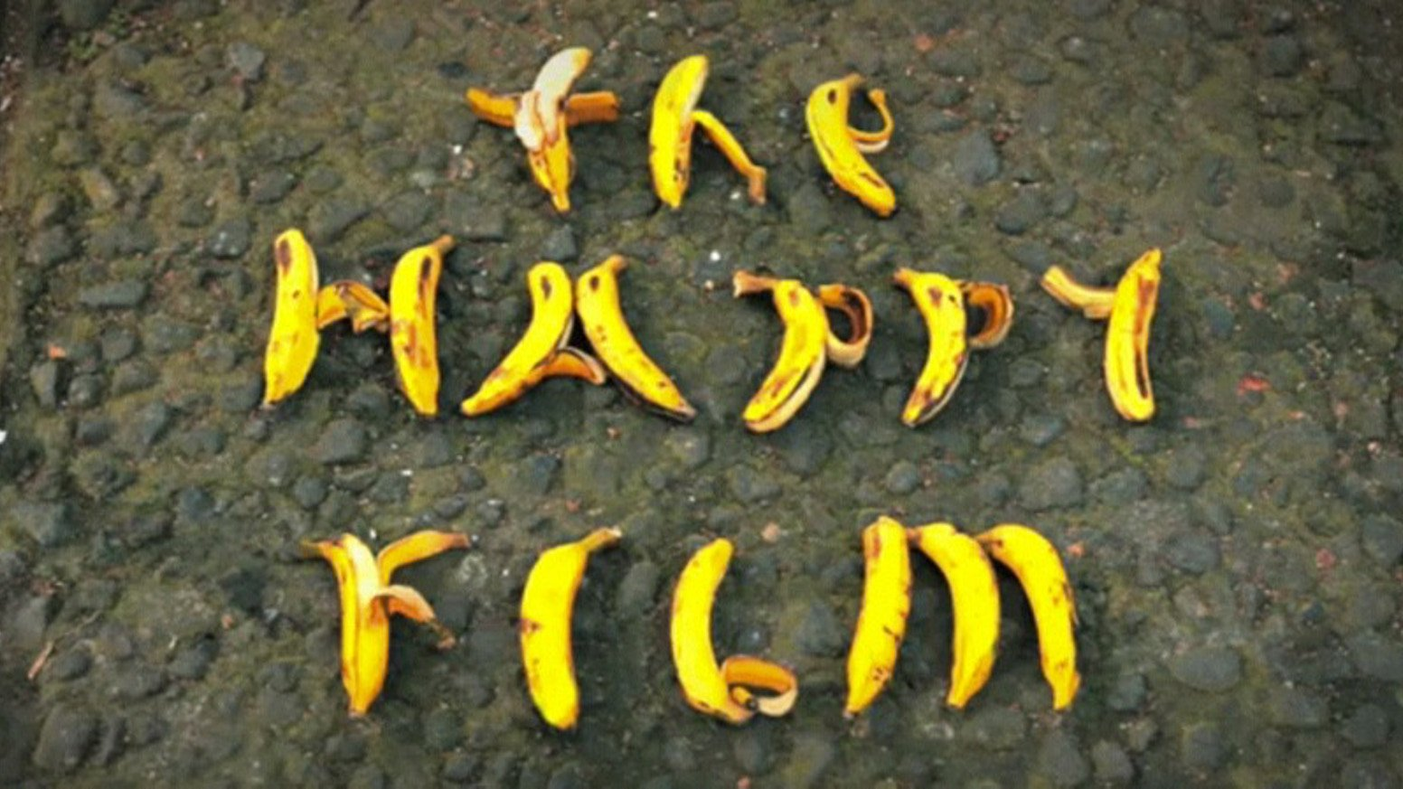


The
Show
Happy
Work
Flim
The
Happy

Slide 7
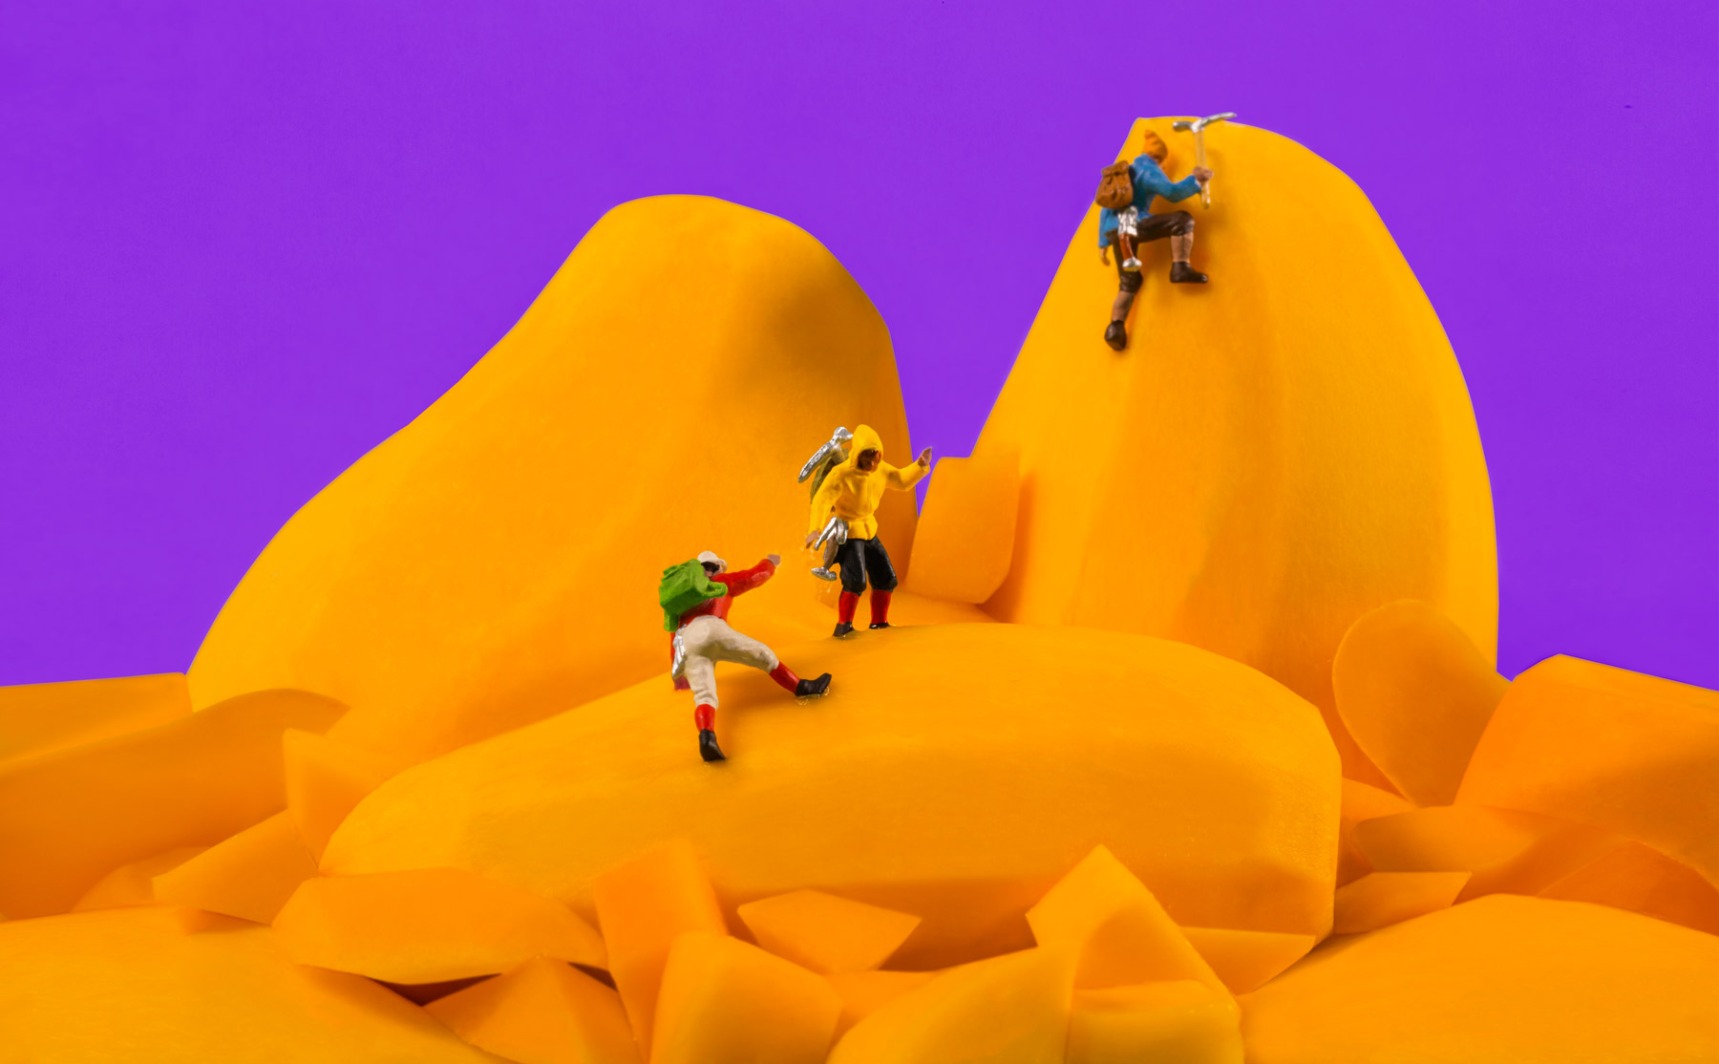




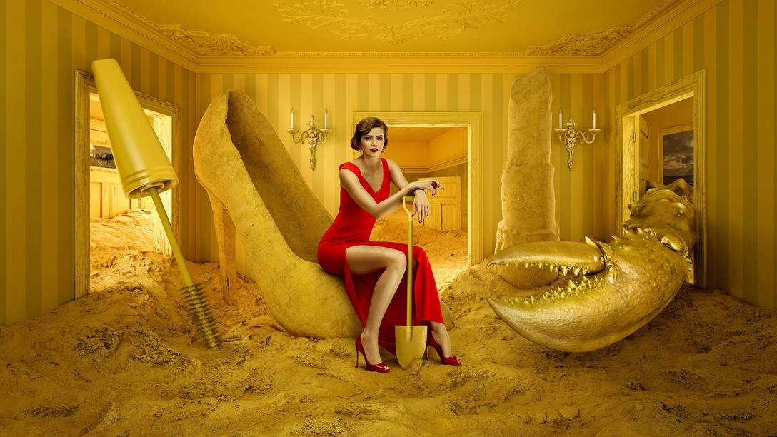

Frooti
Ai
Zon
Work
Aishti

Slide 8



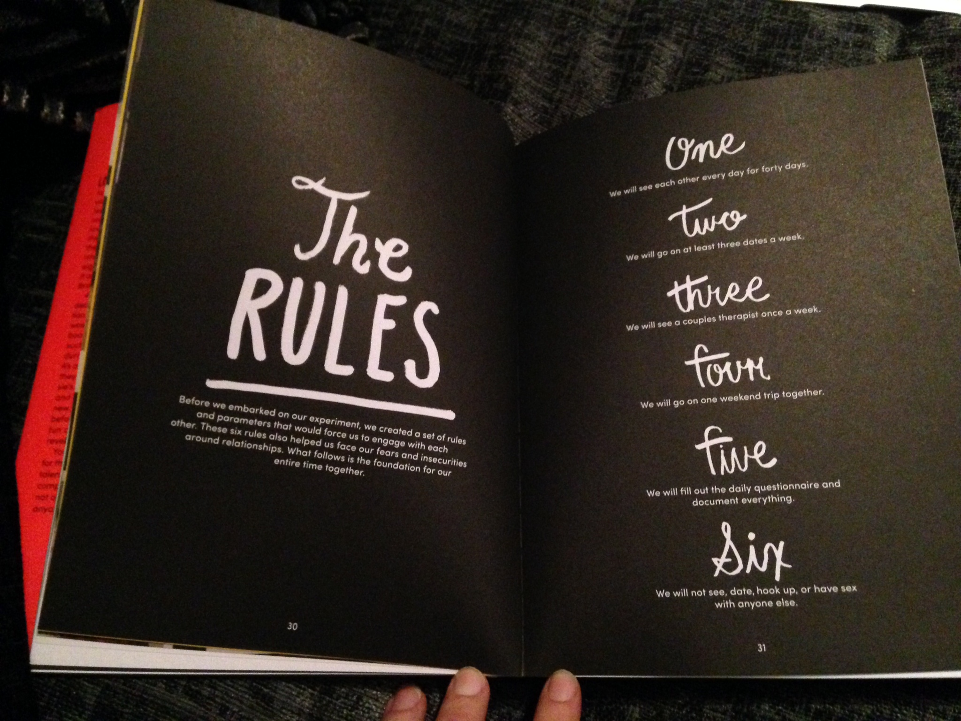
40
Dating
Work
Of
Days

Slide 9
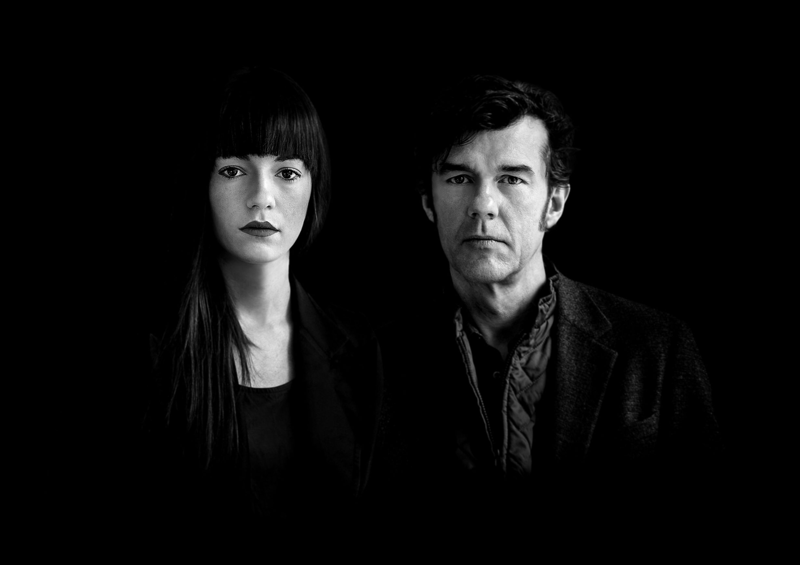


Awards
Webby Award for Websites
Grammy Award
For
Best Home Page
Best Recording Package
Grammy Award
For
Best Boxed

Slide 10
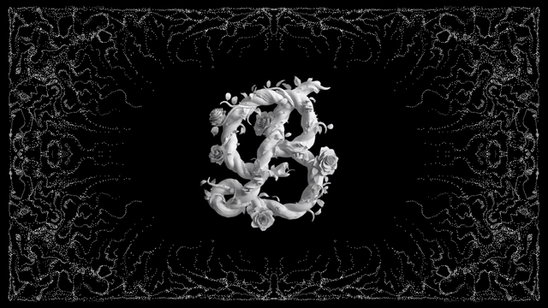
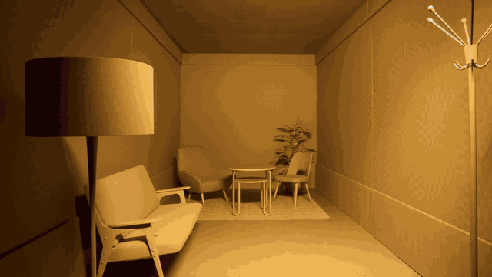
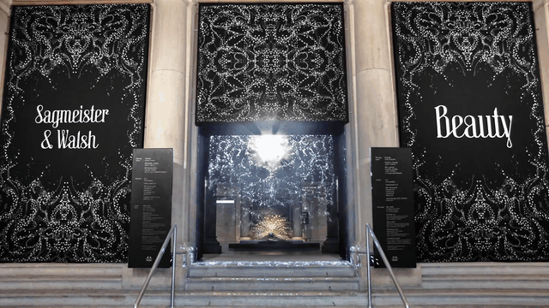

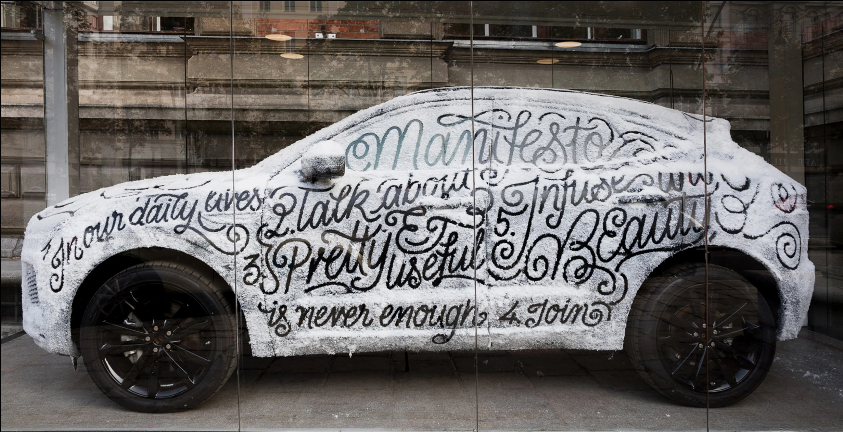
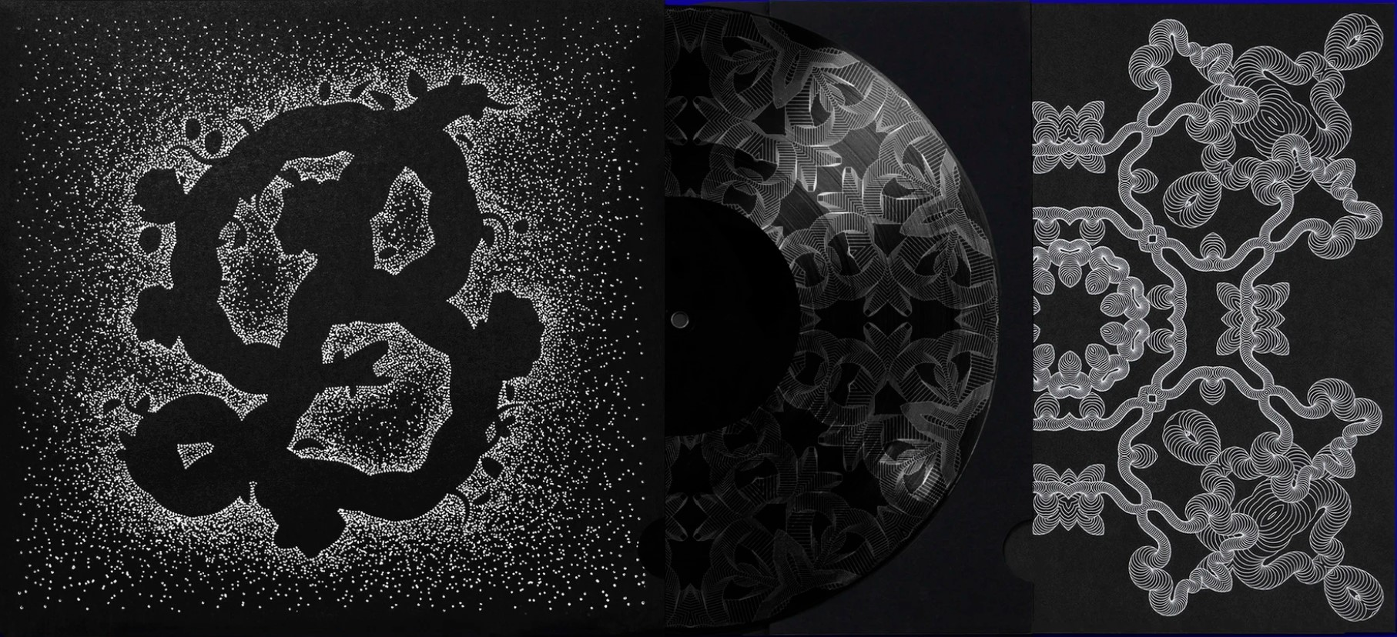
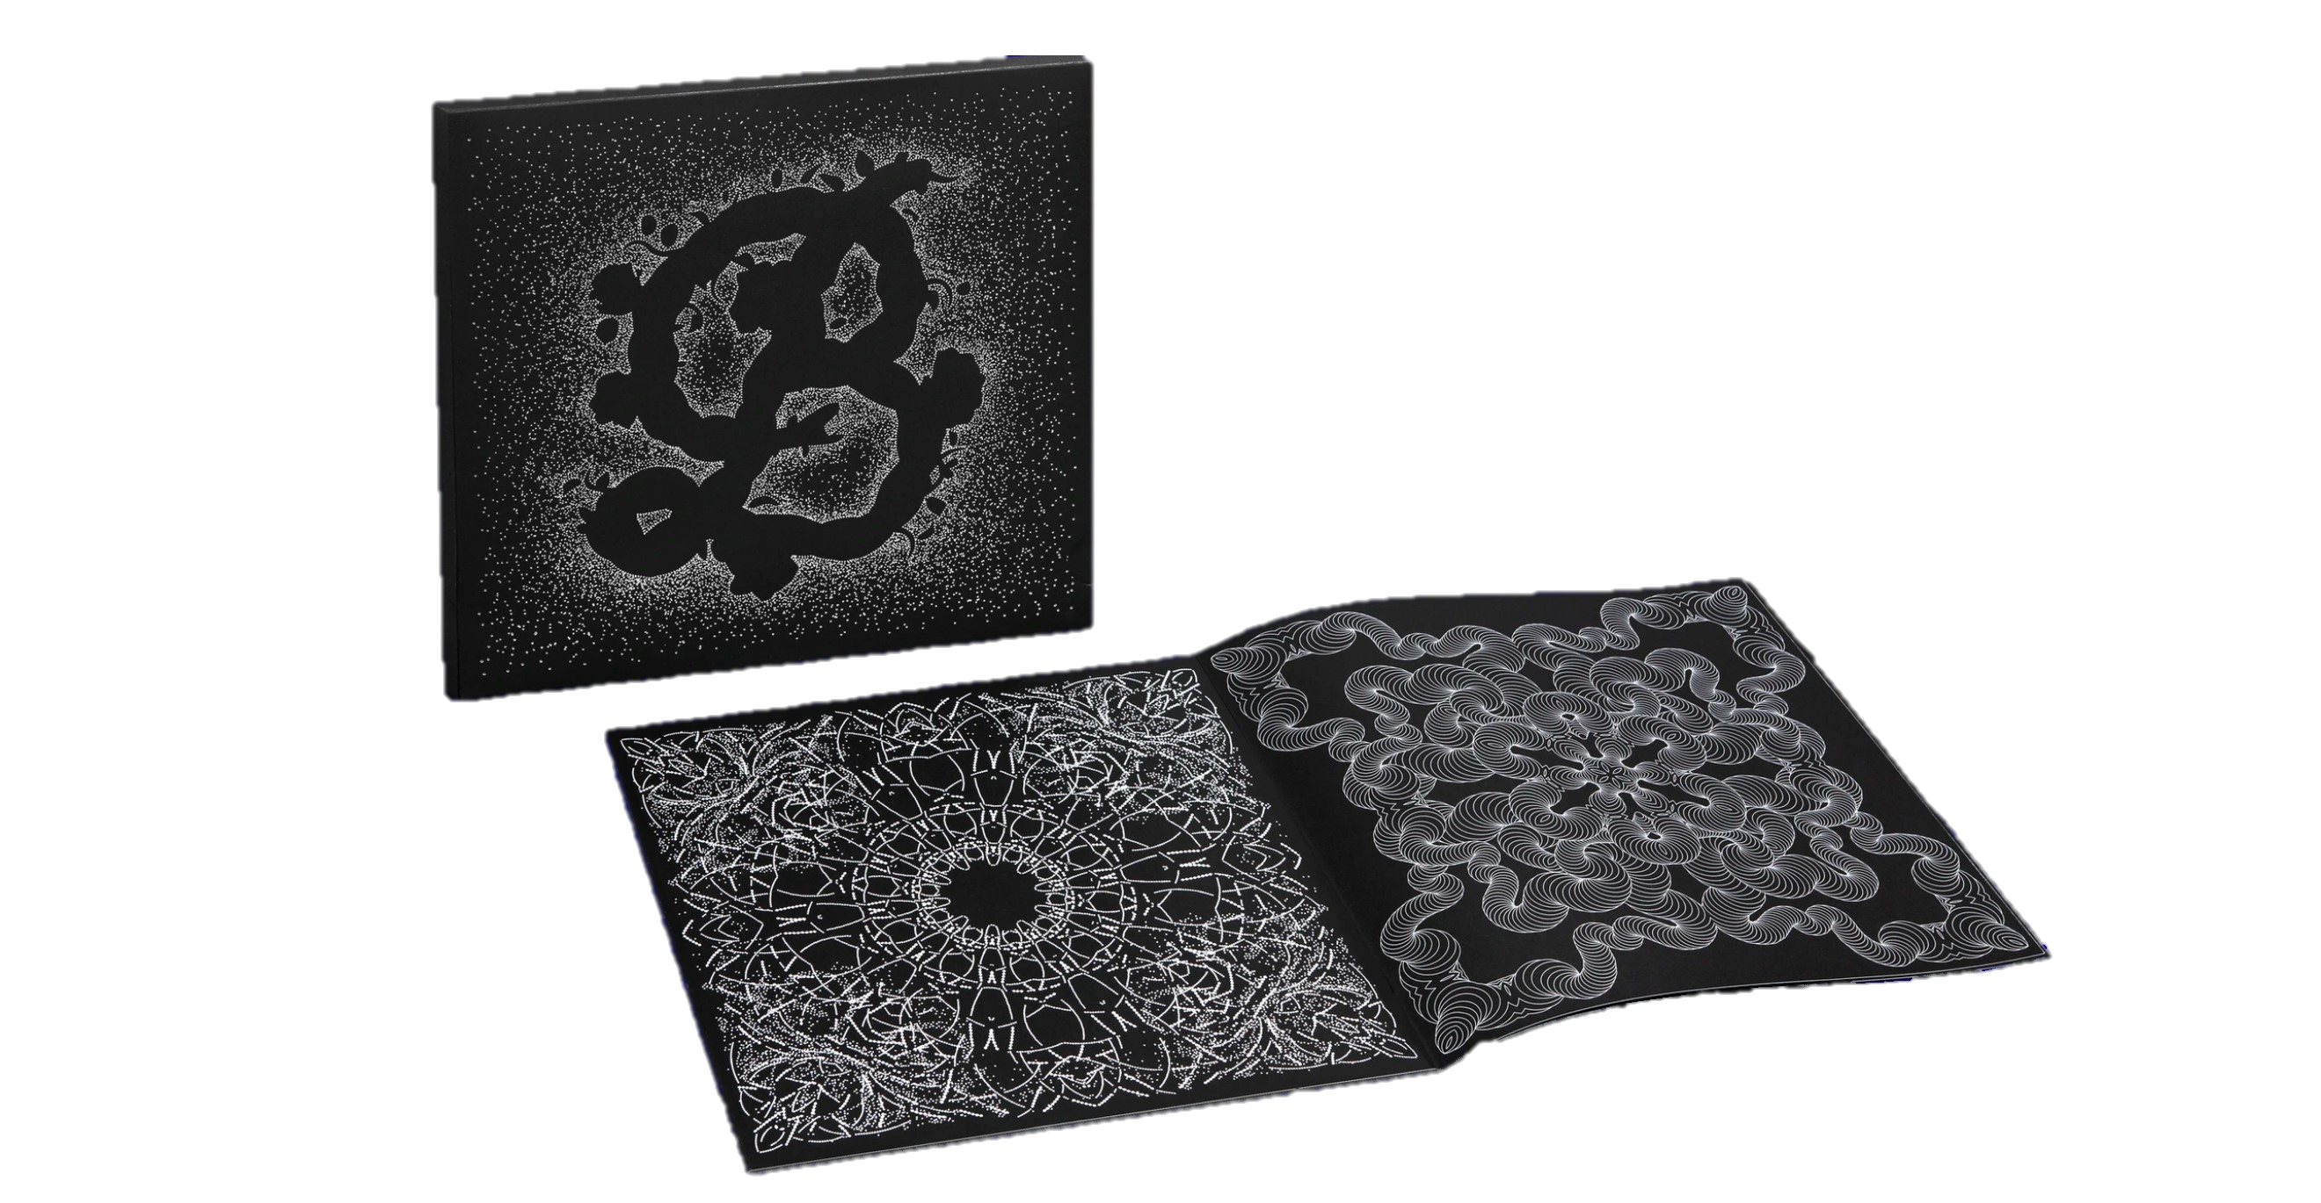
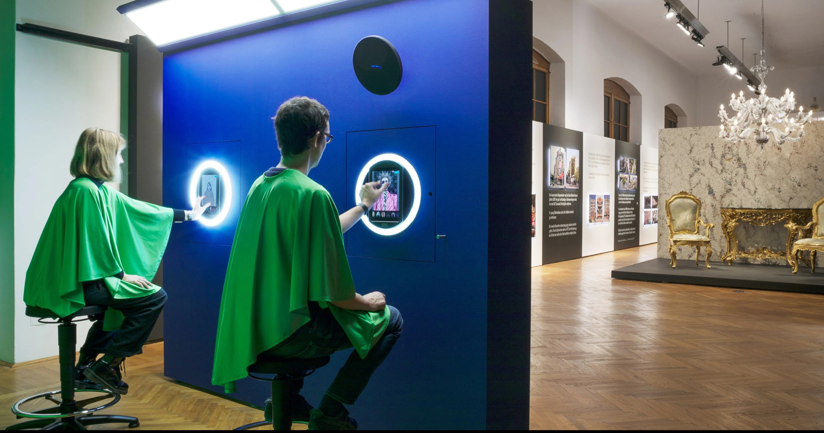
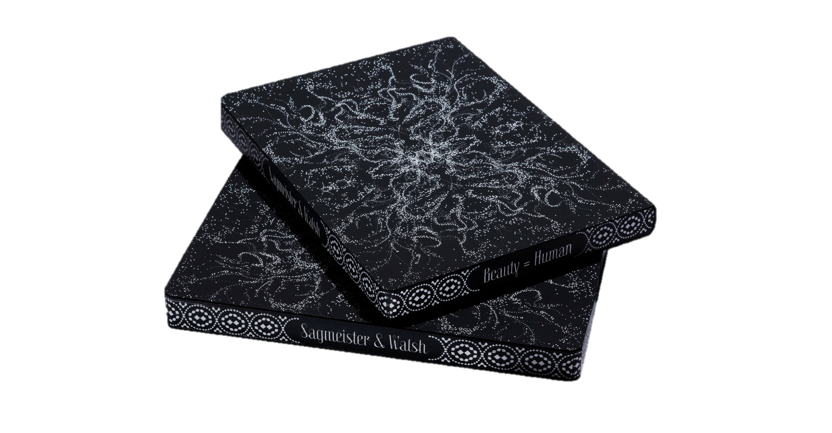
Beauty

Slide 11

Thank you For Listening.
Reference
https://www.nytimes.com/2008/02/01/arts/01iht-DESIGN4.1.9677515.html?pagewanted=1
http://sagmeister.com/
https://andwalsh.com
http://thehappyfilm.org
https://sagmeisterwalsh.com/

